Slide 1
Artificial Intelligence in Chess
An analysis of the use of computers in playing chess, specifically middlegame strategies
By: Anish Doshi
Alex Baranski

Slide 2
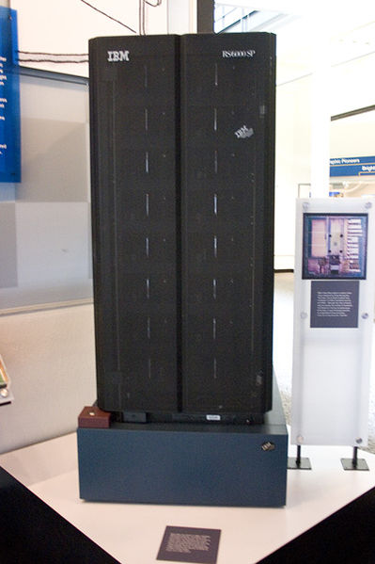
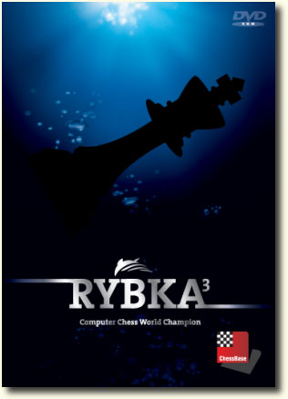
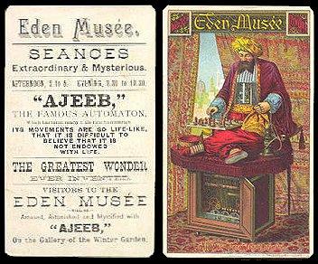
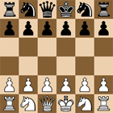
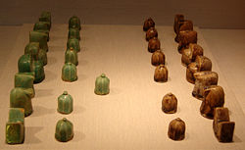
History
1475: modern game evolved
1700-1900: supposed automatons
1900-1950: rise of chess computers
1950-2000: on par with humans
2000-current day: outmatching their creators

Slide 3
The Minimax Algorithm
Minimax: maximizing gain + minimizing loss
Evaluation function
Brute force
Basic method used by chess programs
O(B^{d})
Used not only in chess but also in a variety of other two player games, as well as combinatorics and probability

Slide 4
Modifications to Minimax
Quiescence Search
Avoids horizon effect
Prefers to search “noisy” moves
More akin to humans?
Negamax Algorithm
Exploits zero-sum quality of chess
Simpler than minimax
Negascout

Slide 5
Alpha-Beta Pruning
Improvement to minimax algorithm
O(B^{(d/2)}₎
“Prunes” the minimax tree
Theory: stops evaluating positions when a move that is worse than a previous one is found.
Technicality: a recursive function with two variables, α andβ, where the former is set to infinity and the latter to –infinity.

Slide 6
Cutoffs and Trees
Cutoff: position so good that it need not be evaluated deeper
Null-move heuristic
Killer heuristic: trying to produce another cutoff by adapting moves from other tree
Futility Pruning
Razoring

Slide 7
Extending the Search
Search can and should be extended to analyze “interesting” moves
Captures + recaptures
Checks
Forced move
Opponent sacrificing
Pawn pushes at 7th rank

Slide 8
Pseudocode for our algorithm

Slide 9
Questions?

Slide 10
Sources
Colin, Frayn. "Computer Chess Programming Theory."Colin Frayn's home page. N.p., n.d. Web. 7 Jul 2011. <http://www.frayn.net/beowulf/theory.html>.
George T. Heineman, Gary Pollice, and Stanley Selkow (2008). "Chapter 7:Path Finding in AI". Algorithms in a Nutshell. Oreilly Media. pp. 217–223. 978-0-596-51624-6.
Russell, Stuart J.; Norvig, Peter (2010), Artificial Intelligence: A Modern Approach (3rd ed.), Upper Saddle River, New Jersey: Pearson Education, Inc., p. 167, 0-13-604259-7
McCarthy, John (LaTeX2HTML 27 November 2006). "Human Level AI Is Harder Than It Seemed in 1955". Retrieved 2006-12-20.
Von Neumann, J: Zur Theorie der Gesellschaftsspiele Math. Annalen. 100 (1928) 295-320
John L Casti (1996). Five golden rules: great theories of 20th-century mathematics – and why they matter. New York: Wiley-Interscience. p. 19. 0-471-00261-5.
^ Russell, Stuart J.; Norvig, Peter (2003), Artificial Intelligence: A Modern Approach (2nd ed.), Upper Saddle River, New Jersey: Prentice Hall, pp. 163–171, ISBN 0-13-790395-2
ChessBase.com - Chess News - Bilbao – the humans strike back
Aviezri Fraenkel and D. Lichtenstein (1981), "Computing a perfect strategy for n×n chess requires time exponential in n", J. Combin. Theory Ser. A 31: 199–214, ^ Chess, a subsection of chapter 25, Digital Computers Applied to Games, of Faster than Thought, ed. B. V. Bowden, Pitman, London (1953). Online http://www.turingarchive.org/browse.php/B/7
^ Chess, a subsection of chapter 25, Digital Computers Applied to Games, of Faster than Thought, ed. B. V. Bowden, Pitman, London (1953). Online http://www.turingarchive.org/browse.php/B/7

